Slide 1
Mitigation of Double-spending Attacks in Cryptocurrency Blockchain
BY
Laksha S - 20BAI1186
Rohan Alroy B - 20BAI1245
Shangirne - 20BAI1154
Review 1,2,3

Slide 2
Abstract
Double-spending implies the threat that a ‘digital currency’ like bitcoin, dogecoin etc., can be spent twice.
With the digital currency, there is a higher probability of risk that the holder could make a copy of the digital token and send it to a merchant or another party while retaining the original.
Bitcoin tackled this problem using a worldwide ledger system. It keeps track of time stamped transactions dating back to the cryptocurrency inception in 2009. Every few minutes, information from blocks is updated to the ledger, and all nodes on the network keep a copy of the blockchain ledger.
High-level encryption secures the identities of the buyer and seller in any transaction, as well as the ledger itself from alteration by outside sources. All bitcoin wallets are updated when the blockchain ledger is updated. Rather, all transactions involving the relevant cryptocurrency are recorded on the blockchain, where they are independently validated and secured through a confirmation process. Transactions that have been confirmed in this way in bitcoin and many other cryptocurrencies become irreversible; they are posted publicly and stored in eternity.

Slide 3
MOTIVATION
The motivation behind this project was to solve the existing issues in blockchain. We identified that double spending attack is a serious issue and there's a good chance of hackers exploiting it, thus we came up with a solution of using network observers and alert system to not just identify a double spending attack but also to alert the entire system of the fraudulent node. The existing condition lead us to find and propose a solution to this.

Slide 4
OBJECTIVE
Our basic idea is to notify the sender and receiver about the unauthorized transaction and have an alert system is designed such that the message is passed from the fraudulent node to the sender and receiver nodes.
The objectives have been accomplished using a network observer and an peer alert system.

Slide 5
PROBLEM STATEMENT
We aim to design a Network observer and a Peer-Alert System.
The Network Observer is placed between each pair of nodes.
The surrounding nodes are warned about the fraudulent transaction.
This will assist allowing them to conduct transactions through other secure pathways.
For a modern computer, generating any hash for a set of bitcoin transactions would be cheap, thus the bitcoin network sets a particular level of difficulty to transform the process into work.
This option is changed such that a new block is mined, that is, added to the 8 blockchain by creating a valid hash, every 10 minutes or so.

Slide 6
PROBLEM STATEMENT
The complexity of a hash is determined by its target, so, the lower the target, the narrower the set of valid hashes and the more difficult it is to construct one.
In practice, this means a hash that starts with a long series of zeros.
For example, some block has 2012 transactions totaling a little over 1000 bitcoins, as well as the preceding block's header.
The resultant hash would be unrecognizable if a user altered one transaction amount by 0.0001 bitcoin.
Bitcoin and other decentralized digital currencies use consensus procedures to ensure that transactions are confirmed with certainty.
Proof-to-work mechanisms are another name for consensus techniques. In practice, the process assures that each of the transaction's participants confirms the transaction.

Slide 7
PROBLEM STATEMENT
As a result, Bitcoin includes a historical public ledger aided by blockchain, which allows for empirical proof of property rights and transfers.
Our project is unique in terms of Security, Transactions, Signature, Network Observers and Peer Alert Systems. We show that, unless additional detection algorithms are added into the Bitcoin implementation, double-spending attacks on quick payments are likely to succeed and may be carried out at a minimal cost. We offer a new, lightweight countermeasure that allows double-spending attacks in fast transactions to be detected. Accountability becomes critical in the face of such wrongdoing. We explain how, in the case of Bitcoin, accountability and privacy go hand in hand. To demonstrate this contradiction, we define accountability and privacy for Bitcoin and analyze the privacy and accountability mechanisms in Bitcoin analytically and empirically. When dealing with quick payment scenarios, we believe that this helps reduce the dependency on transaction confirmation. We have examined the criteria for effective double-spending attacks against Bitcoin fast payments in depth. We then present the first implementation of double-spending attacks on Bitcoin fast payments, employing a small number of hosts situated across the world. We have used a systematic approach to summarize and assess the defensive strategies in the blockchain for double-spending attacks. We have also considered the implications of future research paths for defensive measures against the double-spending attacks.

Slide 8
Performing transactions
To perform transactions between the intended sender and recipient blocks or nodes, their addresses are mined, such that the transaction amount can be deducted from the sender node and added to the receiver node. An array contains the records of pending transactions for every block starting with a null amount transaction for the genesis block, and subsequently stores every new transaction.

Slide 9
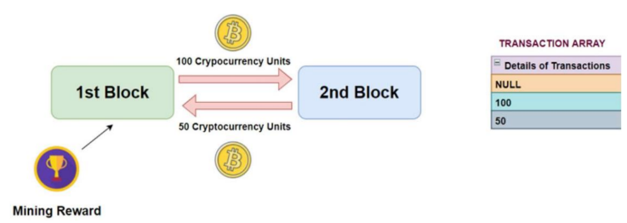
Performing transactions

Slide 10
Double Spending Attack
When a sender tries to perform the same transaction (with the same amount) twice, but with two different receivers, even though his initial balance is not sufficient to satisfy both the transactions, a double spending attack occurs. This can be illustrated in the below example. Considering a sender to have 10 cryptocurrency units, who plans to give these 10 units to 2 different receivers, concurrently, across separate blocks. For both these transactions to occur, a total of 20 units should be available with the sender, whereas he has just 10, implying that he plans to reuse the same money of the first transaction, in the second transaction, such that the 10 units is deducted at the same time (so only 10 units is deducted from his balance finally). As seen above, the same sender hash address (highlighted in yellow) is involved in two transactions of 10 cryptocurrency units each (underlined in blue), but with different receiver hash addresses. Thus, if these 2 transactions are performed simultaneously (i.e. at the same timestamp), only 10 units will be deducted from his balance at the same time, whereas his actual deduction amount should be 20. The sender can thus exploit this issue to his advantage, and perform many such transactions, but by paying only half the actual amount.

Slide 11
Network Observers
A network observer will check the number of pending transactions from a particular sender address in a blockchain. If the payment amount of two pending transactions from that address is the same, and the total amount is greater than the initial balance of the sender, a transaction aborted error will be displayed, and the user will be prompted to either cancel the last transaction with the same amount, or to try performing the transaction later.

Slide 12
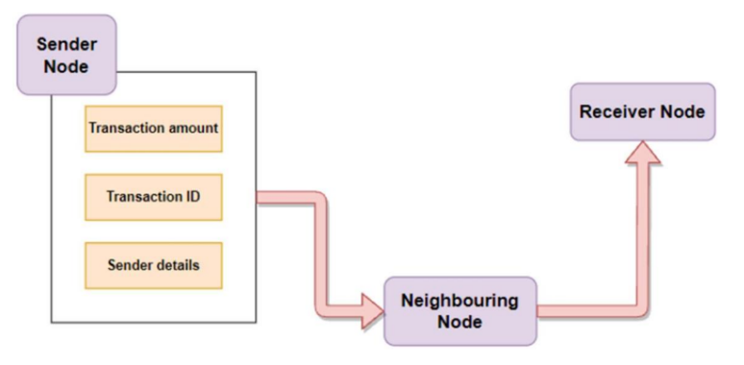
Network Observers

Slide 13
Peer Alert Systems
In order to disconnect from the block where the fraudulent transaction or double spending attack has taken place, the neighboring blocks are alerted. Any subsequent transactions that are scheduled for this block are redirected to other routes, and these neighboring blocks terminate their connections with it. The sender (who wanted to conduct the double spending attack), has to either withdraw any one of the transactions within a given timeout period, or will be blocked temporarily before being able to perform any new transactions again.

Slide 14
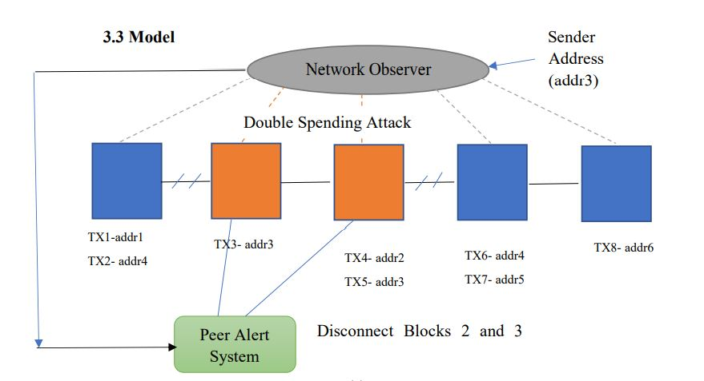
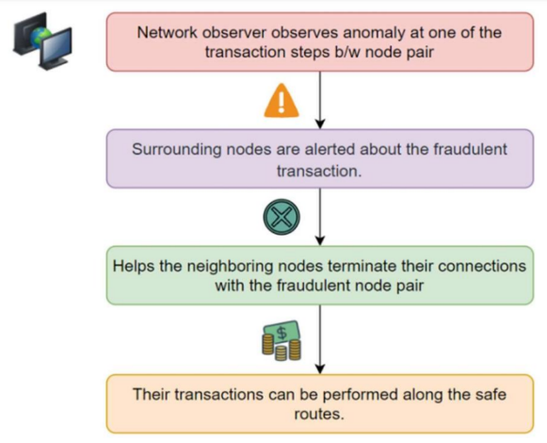
Peer Alert Systems

Slide 15
Signature
To perform transactions between the intended sender and recipient blocks or nodes, their addresses are mined, such that the transaction amount can be deducted from the sender node and added to the receiver node. An array contains the records of pending transactions for every block starting with a null amount transaction for the genesis block, and subsequently stores every new transaction.

Slide 16
Additional Security
To increase security, a random nonce generator is used, that will be used in the hash creation. Moreover, to increase the time taken to mine individual blocks, a difficulty index is used to append additional zeros to the generated hash, which increases the mining time complexity. Also, to validate the cryptocurrency blockchain, for every pair consisting of the current block and its preceding block, a two-fold validation methodology is utilized.
i. The hash of the current block is recomputed with the same nonce, and the original
and recomputed hash values are compared.
ii. The preceding hash of the current block and the hash of the preceding block are
compared.
If a mismatch is found in either of these two steps, the validation function returns an error.

Slide 17
Steps
1) We propose an algorithm where the Network observer is used to track unknown transactions performed without authorization. Further, to notify the sender and receiver about the unauthorized transaction, a peer alert system is designed such that the message is passed from the fraudulent node to the sender and receiver nodes.
2) Each pair of nodes has a network observer installed between them.
3) A sender node will send the transaction amount, transaction ID, and sender data to a
neighboring node.
4) The addresses of the intended sender and recipient blocks or nodes are mined to complete
transactions between them , so that the transaction amount can be deducted from the sender
node and added to the receiver node.

Slide 18
Steps
5) The records of pending transactions for each block are stored in an array, which starts with a null amount transaction for the genesis block and then stores every new transaction.
6) Every transaction is signed with a signature that is generated using the private and public keys, further a hash is calculated for each block using the elliptic library, to ensure that it is unique.
7) After completing the transaction phase, the nearby node will pass this to the matching forward node.
8) This process continues until the amount is received by the recipient node.
9) Each observer keeps a track of the user ids, the number of transactions, and amounts issued
by them.

Slide 19
Steps
10) Based on the number of transactions issued by the user, an observer can check the frequency of node communications in its node pair using this information.
11) The aberration will be logged and transaction aborted error will be displayed if the payment amount of two pending transactions from that address is the same, and the total amount is greater than the sender's initial balance.
12) The sender, who wants to commit a double-spending attack, must either retract any of the transactions within a specified timeout period, or he/she will be temporarily blocked from doing any new transactions.
13) Any future transactions authorized for this block will be diverted to alternate routes.
14) The surrounding nodes are warned about the fraudulent transaction when a network observer notices an irregularity at one of the transaction steps between a node pair
15) The preceding hash is utilized as one of the parameters to generate the current hash of any block, the peer alert system will nullify the preceding hash of blocks that had fraudulent blocks preceding them.
16) This will assist neighboring nodes in terminating their connections with the fraudulent node pair, allowing them to conduct their transactions through other secure routes.

Slide 20
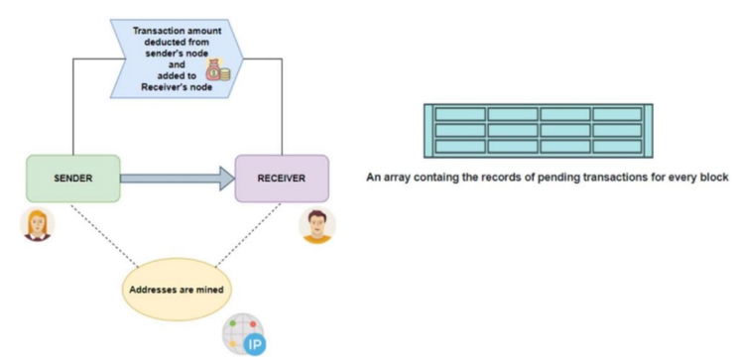
Signature

Slide 21
REVIEW - 2
PARTIAL IMPLEMENTATION
Mathematical Model - Making the signature
We’ll need the message to sign and the private key (da) to sign it with in order to make a signature. This is how the "simplified" signing procedure looks:
i. Make a hash (e) of the message you want to sign.
ii. For k, generate a safe random value.
iii. Calculate point (x1, y1) on the elliptic curve by multiplying k by the elliptic curve's G constant.
iv. Determine r = x1 mod n. Return to step 2 if r equals zero.

Slide 22
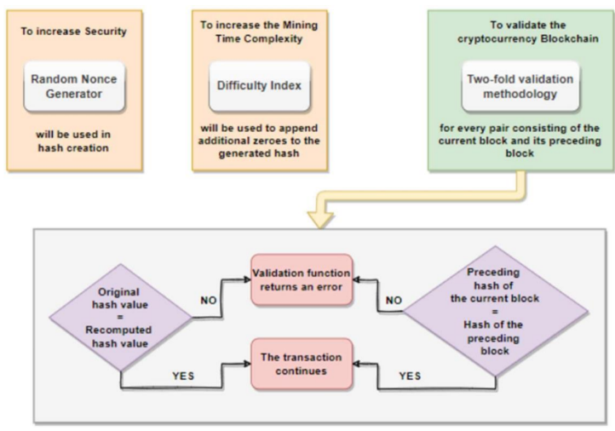
Architecture

Slide 23
Mathematical Model - Making the signature
v. Determine s = k1(e + rda) mod n. Return to step 2 if s equals zero.
vi. Keccak256("x19Ethereum Signed Message: n32" + Keccak256(message)) is commonly used to calculate the hash in Ethereum. This prevents the signature from being used for anything other than Ethereum.
The signature we get is different every time since we use a random number for k. When k isn't sufficiently random or the value isn't secret, the private key can be calculated by combining two signatures ("fault attack"). However, how can this be secure if the output of a message signed in MyCrypto is the same every time? The RFC 6979 standard, which explains how to produce a secure value for k based on the private key and message, is used in these deterministic signatures (or hash).

Slide 24
Recovering the Public Key
Steps for recovering public key
i. To recover the message, calculate the hash(e).
ii. Calculate the elliptic curve point R = (x1, y1), where x1 equals r for v = 27, or r + n for v = 28.
iii. Calculate u1 = -zr1 mod n and u2 = sr1 mod n for u1 and u2 respectively.
iv. Qa = (xa, ya) = u1 G + u2 R = u1 G + u2 R = u1 G + u2 R = u1 G + u2 R = u1 G + u2 R = u1
v. The point of the public key for the private key used to sign the address is Qa. We can get an address from this and compare it to the address provided. The signature is legitimate if it does.

Slide 25
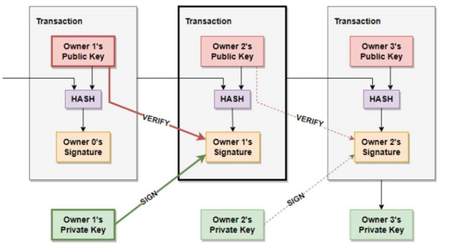
Recovering the Public Key

Slide 26
Recovering the Public Key
In the first transaction, Owner 1’s public key is present which is verified by the next owner’s signature and further converted into hash value and current owner’s signature. Furthermore, The private key of the 1st owner is signed by the next owner’s signature. Similarly, in the second transaction the public key is verified by the third owner’s signature and the private key is signed by the third owner’s signature and further converted in hash value and signature. This loop continues until all the transactions get completed.

Slide 27
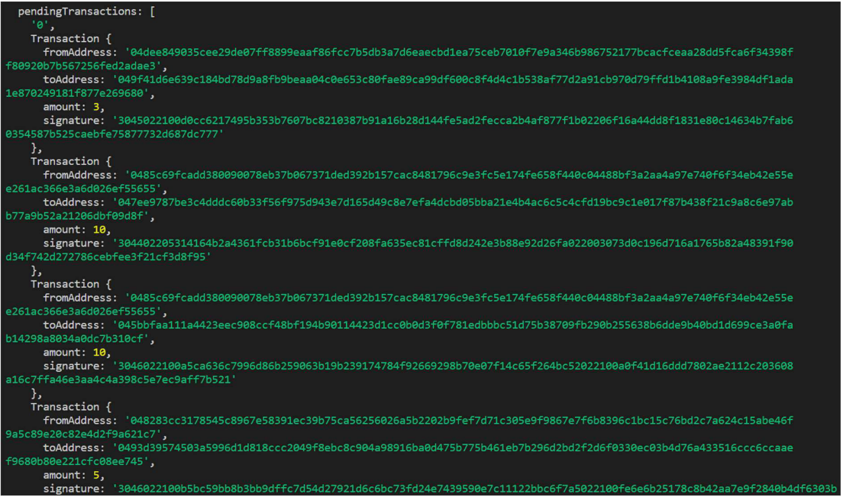
REVIEW 3
FINAL OUTPUT SCREENSHOTS

Slide 28
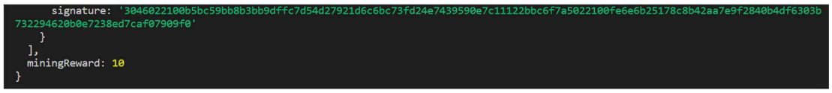
SCREENSHOTS

Slide 29
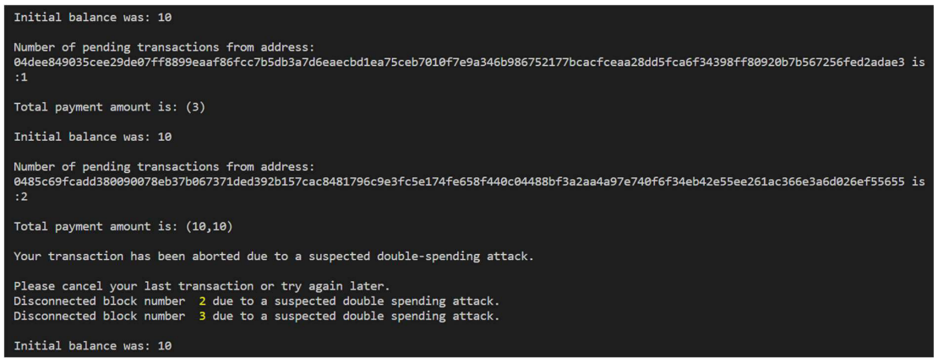
SCREENSHOTS

Slide 30
To increase security, a random nonce generator is used, and it will be used in the hash construction. The computed hash is additionally extended with more zeros using a difficulty index, which increases the complexity of the mining process. The cryptocurrency blockchain is also validated twice, once for the current block and once for its predecessor, for each pair.
The current block's hash is recalculated using the same nonce, then the original and recalculated hash values are compared.
The previous hash of the present block and the previous block's hash is compared.
The validation method produces an error if there is a discrepancy in either of these two steps.
Before interfering with any of the blocks, we monitor and log the result of the verify chain validity function, which returns the value true, signalling that the blockchain is genuine.
RESULTS & DISCUSSION:

Slide 31
Since Bitcoin is a digital currency and there is no central authority to check its spending records, double spending is a risk. According to our analysis, a market player would require a lot of computational effort to doublespend a transaction fraudulently by erasing the previous blocks in the chain. Further validating the integrity of the transaction is the block's exponentially increasing number of confirmations over time. When dealing with quick payment circumstances, we believe that this helps reduce the dependency on transaction confirmation.
Research has been done into the factors that make double-spending attacks against Bitcoin quick payments effective. Our project is distinctive in terms of security, transactions, signatures, network observers, and peer alert systems. We demonstrate that, absent the inclusion of new detection algorithms to the Bitcoin implementation, double-spending attacks on quick payments are likely to be successful and may be executed at a low cost.
CONCLUSION & FUTURE WORKS

Slide 32
We offer a fresh, simple defence against double-spending attempts in quick transactions. Accountability becomes essential in the face of such misconduct. In order to assist the user, this project aims to construct a Network Observer and a Peer-Alert System. In this design, the Network Observer is placed in-between each pair of nodes.
When a network observer detects an anomaly at one of the transaction steps between a node pair, the Peer Alert system alerts the nearby nodes about the fraudulent transaction. As a result, the nearby nodes will be able to cut off their connections to the fraudulent node pair and carry out their transactions over other secure channels.
A hash's complexity is governed by its "target"; the lower the target, the smaller the set of acceptable hashes, and the more challenging it is to create one. To compile and assess the defences against double-spending threats in the blockchain, we used a methodical approach. Future research directions' implications for defences against double-spending attacks have also been taken into account.
CONCLUSION & FUTURE WORKS

Slide 33
THANK YOU

